Slide 1
Create a custom Watson Speech to Text model using specialized domain data
EXTERNAL MENTOR
1. Aditya Maheshwari
2. Jitendra Suremali
INTERNAL MENTOR
1.Nilakshi Gogoi
Submitted By:
1. Hafiz Hussain (ET16BTHCS063), CSE
2. Hunnan Hussain (ET16BTHCS023), CSE
3. Nawed Zaman (ET16BTHCS066), CSE (Group Leader)
4. Dipak Gogoi (ET16BTHCS064), CSE
5. Engan Panggeng (ET17BTHEE022L), EE
6. Saurav Thakuria (ET16BTHCS065), CSE

Slide 2
Contents
Featured Technologies
Understanding of Project
Datasets- Source/Size
Flow Diagram
Procedure
Result
Future Scope
Conclusion

Slide 3
Featured Technologies
Front-End: Html, Bootstrap, CSS
Back-End: Node.js, react
Watson Speech Recognition
Watson Speech Customization
AI in Medical Services

Slide 4
Understanding of Project
We will create a custom speech to text model. The Watson Speech to Text service is among the best in the industry. However, like other Cloud speech services, it was trained with general conversational speech for general use; therefore it may not perform well in specialized domains such as medicine, law, sports, etc. To improve the accuracy of the speech-to-text service, you can leverage transfer learning by training the existing AI model with new data from your domain.
In this project, we will use a medical speech data set to illustrate the process. The data is provided by ezDI and includes 16 hours of medical dictation in both audio and text files.

Slide 5
DataSets- Source/Size
DataSets: Medical Domain Data
Source : ezDI
Size : 16 hours of medical dictation(audio and transcriptions)

Slide 6
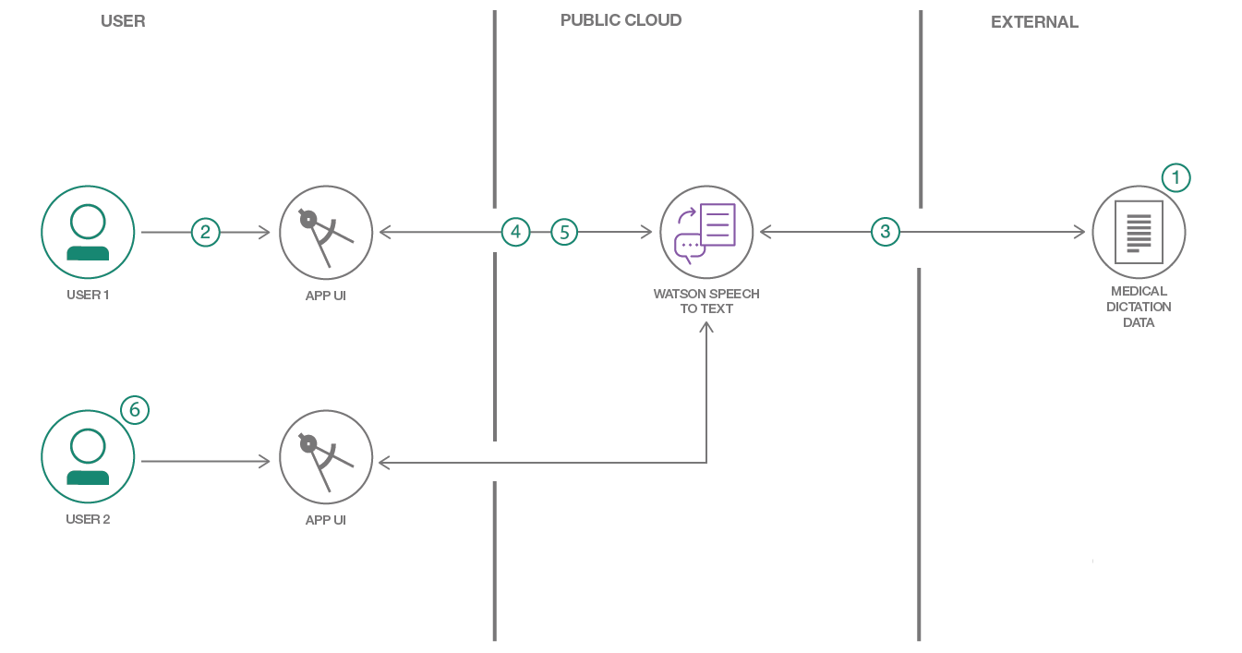
Flow Diagram

Slide 7
Procedure
Create IBM Cloud services
Configure credentials
Download and prepare the data
Train the models
Transcribe your dictation
Correct the transcription

Slide 8
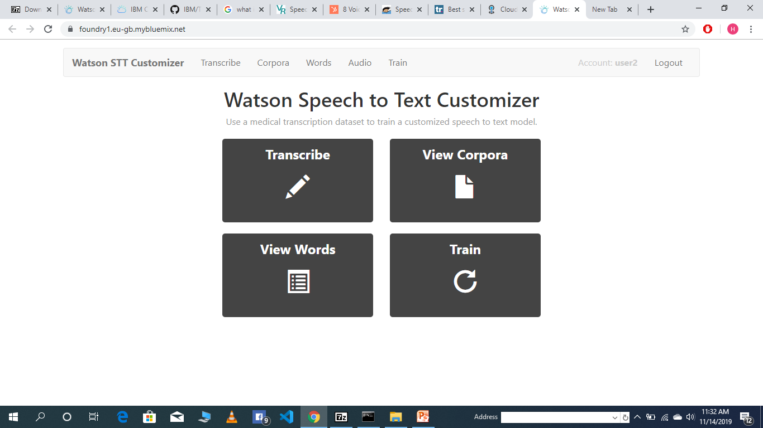
User Interface

Slide 9
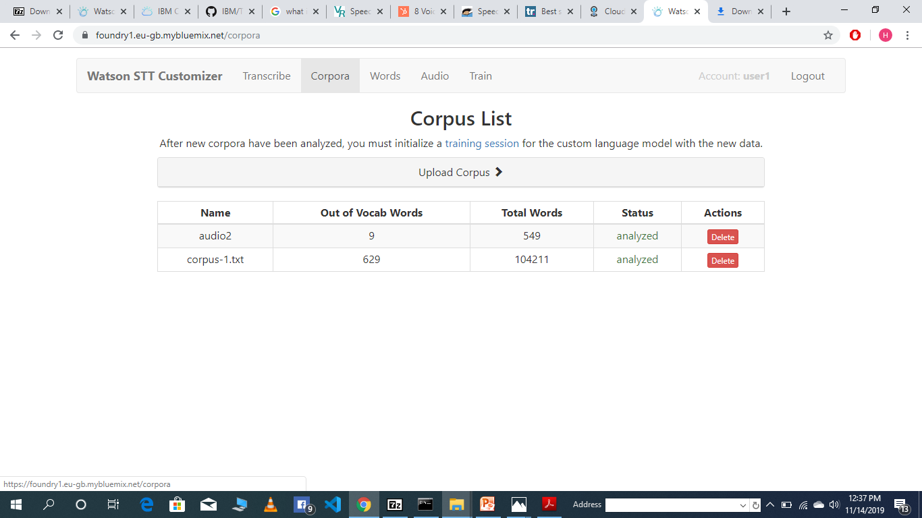

Slide 10
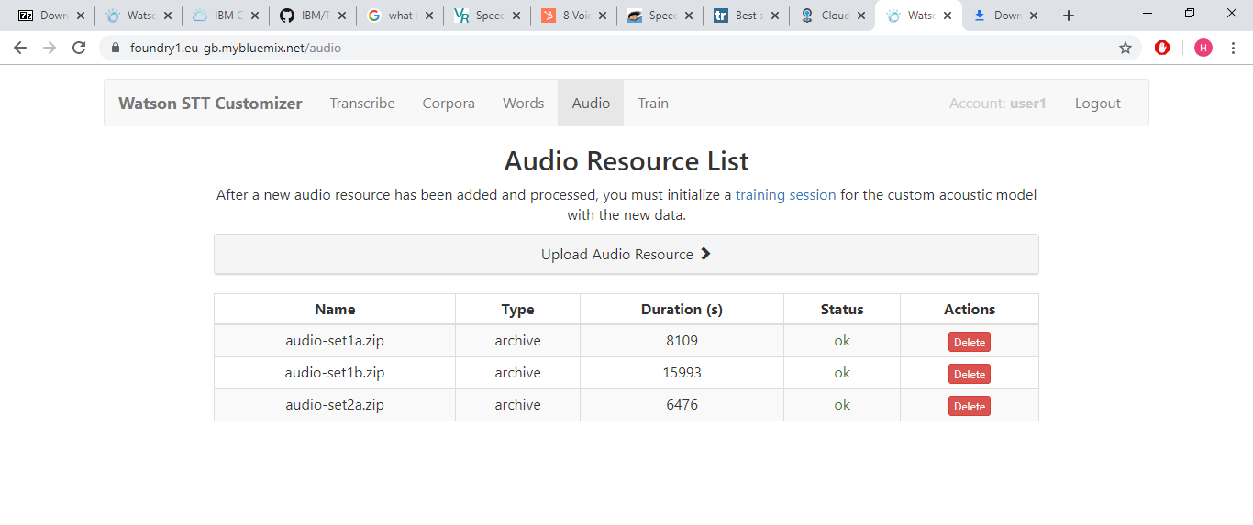

Slide 11
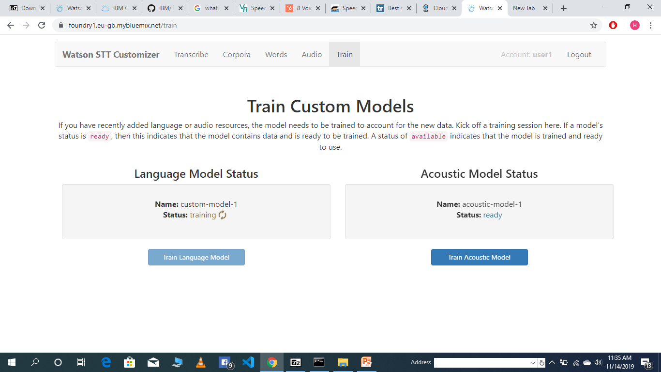

Slide 12
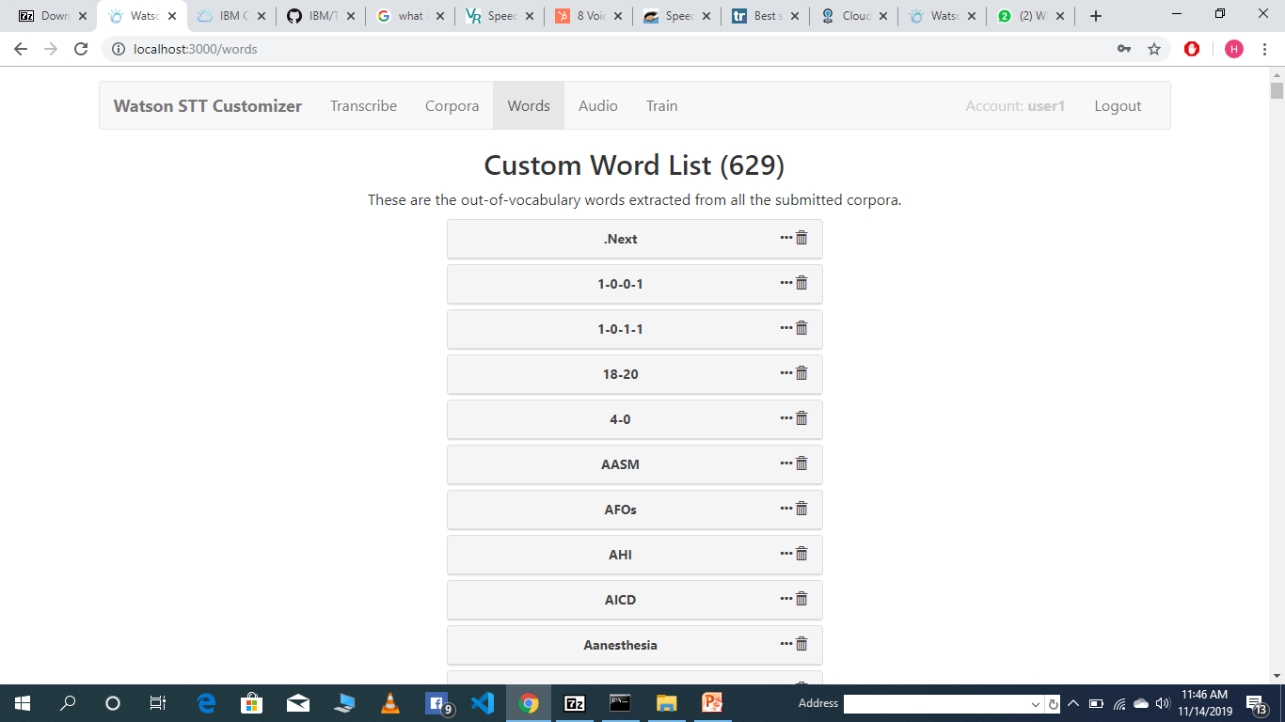

Slide 13
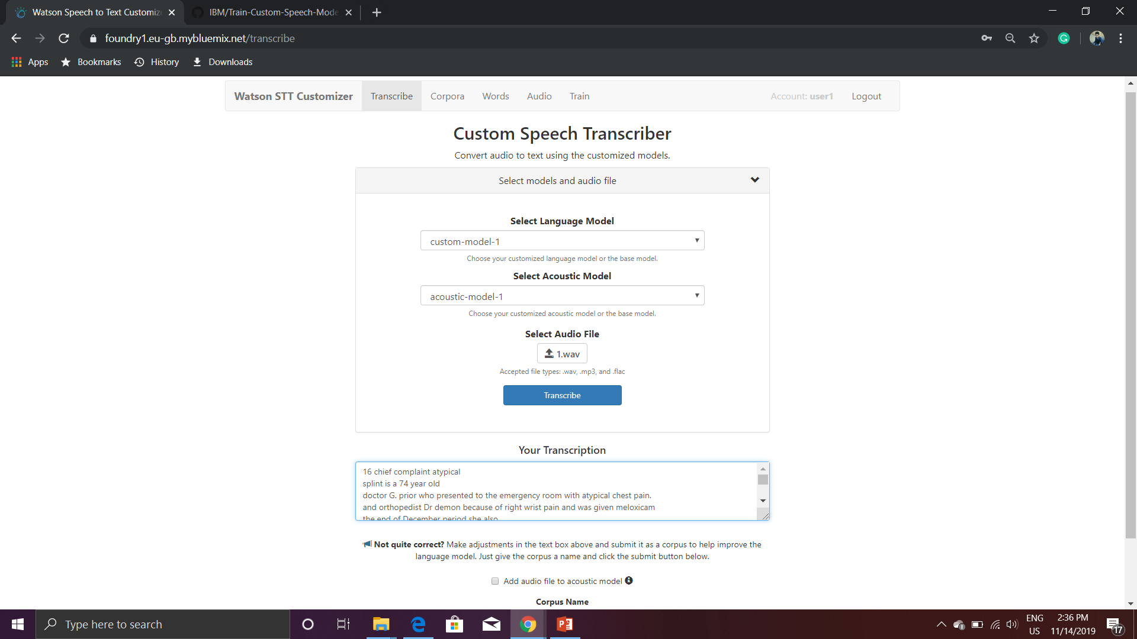

Slide 14
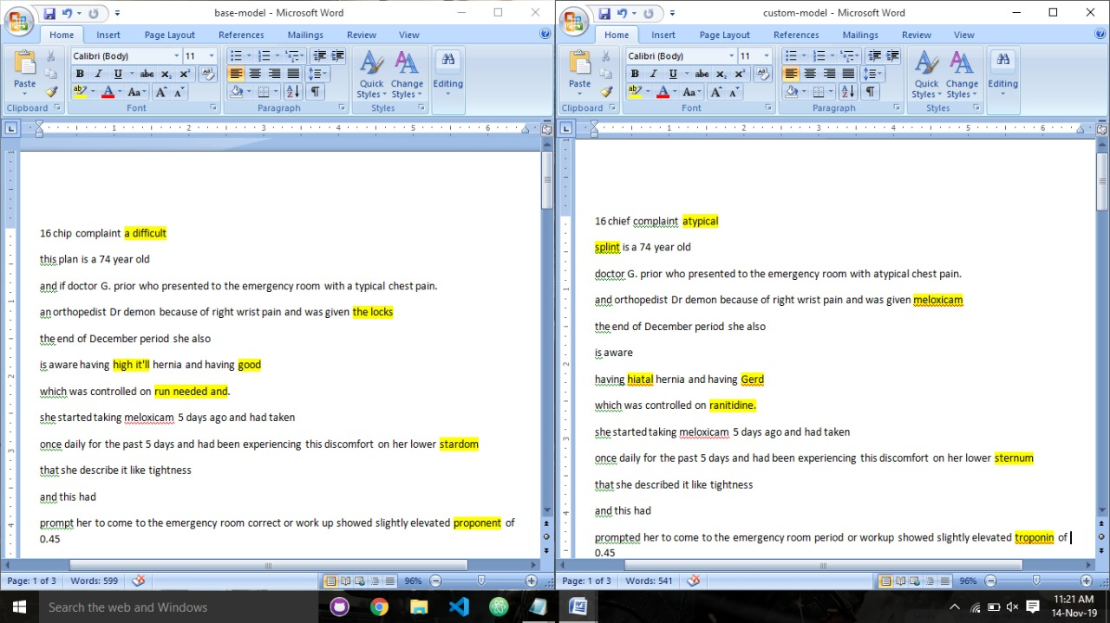
Result
BASE MODEL
CUSTOM-MODEL

Slide 15
Future Scope
Accuracy will become better and better
Dictation speech recognition will gradually become accepted
Microphone and sound systems will be designed to adapt more quickly to changing background noise levels, different environments, with better recognition of extraneous material to be discarded.

Slide 16
Conclusion
This Web Application gives us the ability to create custom speech to text service using IBM Watson.
This makes our application:-
Easy to Transcribe
Increased Accuracy and
Self Improvement

Slide 17
Thank You!

